Slide 1
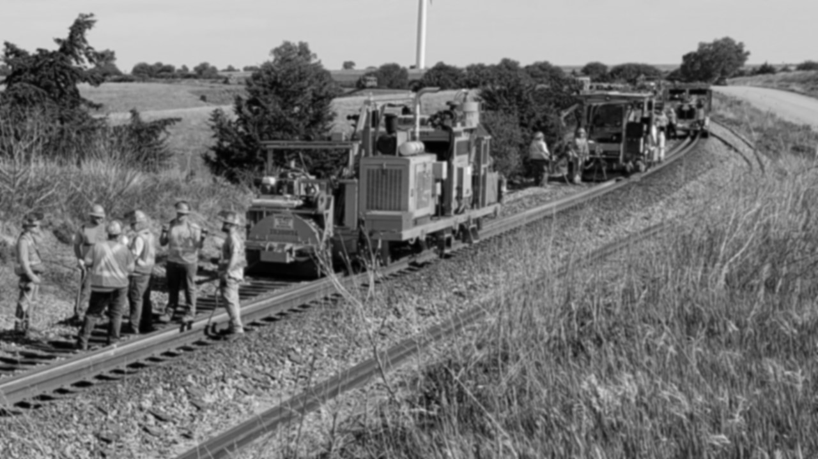
ORGANIZING
“I am ready to face any challenges that might be foolish enough to face me.”
-Dwight Schrute
Assistant (to the) Regional Manager,
Dunder-Mifflin Paper Co.
Burlington System Division – BMWED-IBT
Revised January 2023

Slide 2
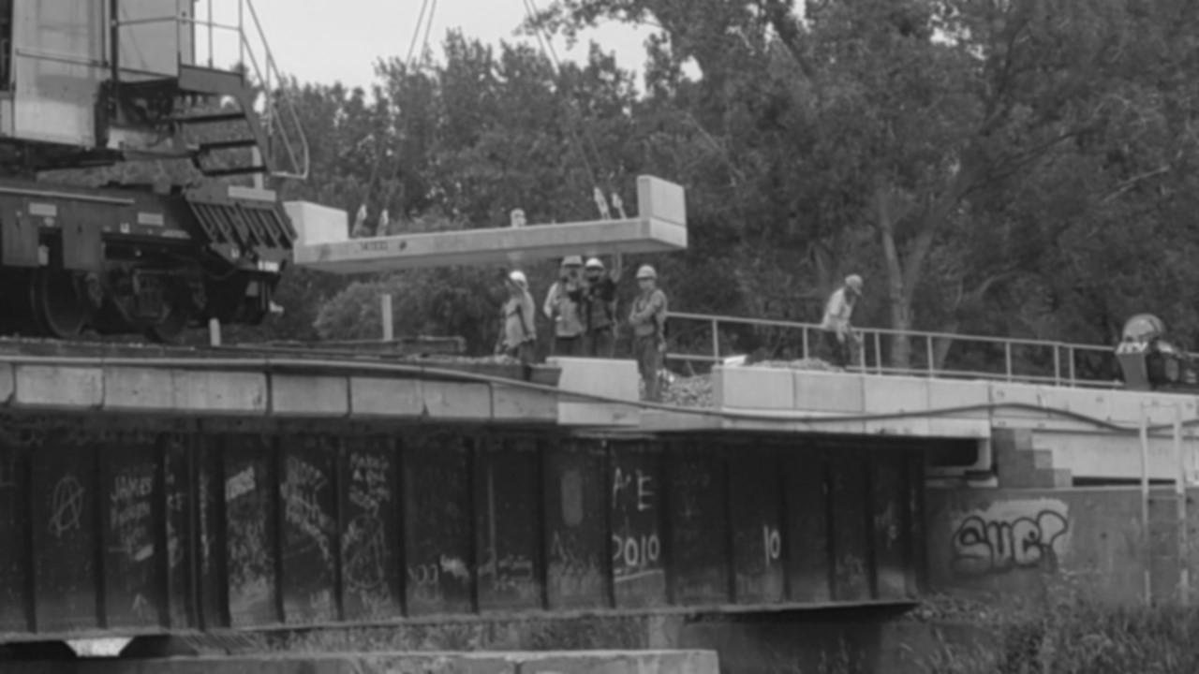
SCENARIO
Your Lodge (table) just got word that you need to stage an informational picket/rally in 3 weeks to support a campaign against the Grand Continental Railroad (GCRR) and their implementation of fully automated production tampers to surface track.
You have 10 minutes, at your table, to figure this out. Refer to the info. sheets and worksheet for guidance.
A representative at your table will present and answer questions about your plan.
Burlington System Division – BMWED-IBT
Organizing Practical Exercise —Revised January 2023

Slide 3
SCENARIO
Burlington System Division – BMWED-IBT
Organizing Practical Exercise —Revised January 2023

Slide 4
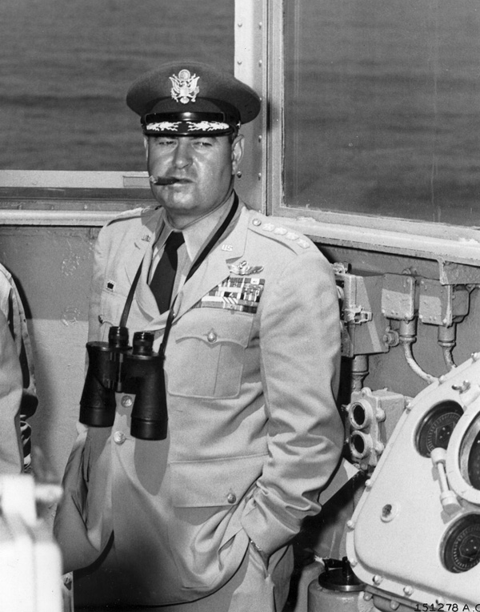
“Execute Your
War Plan!”
What are you doing?
Where are you going?
When is it happening?
Who is coming?
How are you getting the word out?
Who is getting in your way?
Who is helping you out?
Why did you do it this way?
General Curtis LeMay, USAF,
being himself during the Cold
War
Burlington System Division – BMWED-IBT
Organizing Practical Exercise —Revised January 2023

Slide 5
A Goal, without a Plan, is just a Wish
WHAT IS ORGANIZING?
WHY DO WE ORGANIZE?
WHO IS AN ORGANIZER?
WHERE DO WE GO FROM HERE?
Burlington System Division – BMWED-IBT
Organizing Practical Exercise —Revised January 2023

Slide 6
Tasks for a Union Organizer
GATHER INFORMATION
IDENTIFY LEADERS AND COMMUNICATORS
BUILD CONNECTIONS AND BUILD TEAMS
LOOK FOR WAYS TO RAISE HELL
KNOW WHERE TO GET SUPPORT & RESOURCES
KEEP THE FIRE LIT
Burlington System Division – BMWED-IBT
Organizing Practical Exercise —Revised January 2023

Slide 7
Challenges for a Union
Organizer
MISINFORMATION
BAD HISTORY
FEAR
BUREAUCRACY
KEEPING A SENSE OF BALANCE
GOING BACK TO THE WELL
Burlington System Division – BMWED-IBT
Organizing Practical Exercise —Revised January 2023

Slide 8
Things to Remember as You Organize for Action!
TYING AN ACTION INTO A CAMPAIGN (PREPARATION, FOLLOW-UP, “BIG PICTURE”)
IDENTIFY ALL THE STAKEHOLDERS IN AN ACTION, FOR ALL SIDES (ALLIES, ANTI-UNION, NEUTRALS)
GAUGE, MANAGE, AND SUPPORT THE ENERGY OF YOUR PARTICIPANTS.
SAFETY
LOGISTICS
Burlington System Division – BMWED-IBT
Organizing Practical Exercise —Revised January 2023

Slide 9
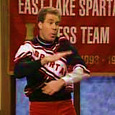
Who are YOU as an Organizer?
YOU ARE NOT A
CHEERLEADER
FOR OUR UNION
Will Ferrell as Craig Buchanan,
Spartan Cheerleader, on
Saturday Night Live
Burlington System Division – BMWED-IBT
Organizing Practical Exercise —Revised January 2023

Slide 10
Who are YOU as an Organizer?
YOU ARE A WORKER WHO CARES ABOUT THE FOLKS AROUND YOU. YOU ARE A PERSON WHO TURNS IDEAS IN ACTION. YOU COMMUNICATE, YOU INFORM, AND YOU EMPOWER US ALL.
Burlington System Division – BMWED-IBT
Organizing Practical Exercise —Revised January 2023

Slide 11
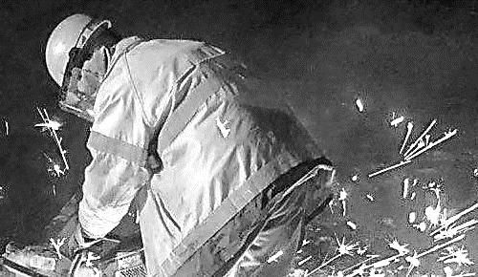
WE ARE THE BURLINGTON
SYSTEM DIVISION, BMWED
WE ARE READY TO WORK.
WE ARE READY TO ACT.
YOU ARE AN IMPORTANT PART OF WHO WE ARE AND WHAT WE BECOME.
SO, LET’S GET TO WORK.
Burlington System Division – BMWED-IBT
Organizing Practical Exercise —Revised January 2023

