Slide 1

WHISTLEBLOWER PROTECTION FOR RAILROAD WORKERS
WHAT YOU NEED TO KNOW ABOUT THE MOST SIGNIFICANT MODERN RAILROAD WORKER PROTECTION LAW
Roy Morrison, Safety Director, BMWED

Slide 2
Overview of Program
Summary of Legal Standards
Examples
Overview of procedures of DOL/OSHA
Federal court procedures
Case developments
Important Legal Issues

Slide 3
What is §20109 ?
49 U.S.C. §20109, also known as Whistleblower Protection, is an amendment to the FRSA (Federal Railroad Safety Act ) that creates workers rights, rail carrier duties, and a set of enforcement procedures.

Slide 4
Summary of its Core Elements
Railroads may not take any adverse employment action against railroad employees who have participated in protected activity (whistle-blowing).
Railroad employees who suffer retaliation for engaging in a protected activity may file a complaint with DOL-OSHA and later may be able to file a civil action in federal court.
Remedies may include both compensatory and punitive damages such as:
  Reinstatement to the same position/same seniority level
  Back pay plus interest
  Attorney fees and costs
  Compensatory damages, such as emotional distress, loss of reputation, economic damages resulting from a loss of income
  Punitive damages up to $250,000

Slide 5
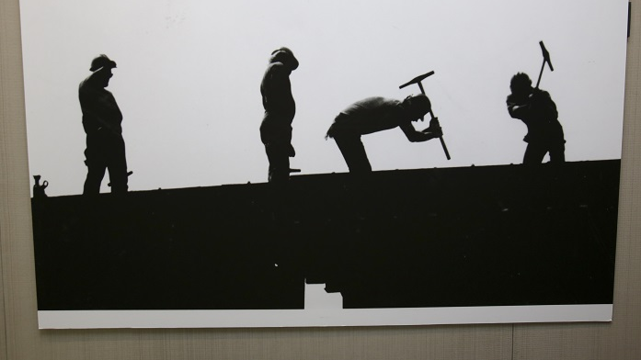
Who is covered by §20109 ?
Any railroad employee:
who engaged in “protected activity;”
where the railroad knew or suspected that the employee engaged in protected activity;
where the employee suffered an adverse employment action; and
the protected activity contributed to the adverse employment action.

Slide 6



What is Protected Activity?
Protected activity includes:
(i) Providing information regarding any conduct which the employee reasonably believes constitutes a violation of any Federal law, rule, or regulation relating to railroad safety or security;

Slide 7
How §20109 protects employees who report unsafe conditions
Reporting unsafe track, bridge, and equipment conditions is a protected activity:
Railroads are prohibited from retaliating against workers for making these reports.
Railroads cannot discipline or threaten discipline against workers trying to protect the public, other workers, themselves, and the railroad.

Slide 8


This Includes:
Protected activity includes:
(ii) Notifying or attempting to notify a railroad carrier or the FRA of a work-related personal injury

Slide 9

How §20109 Protects Employees who Report Injuries
Reporting an injury is a protected act;
A railroad employer cannot begin disciplinary proceedings solely because an employee reported an injury;
A railroad employer is prohibited from taking any adverse action, including delaying prompt and complete medical attention, solely because the employee has been injured and/or wants to report it.

Slide 10
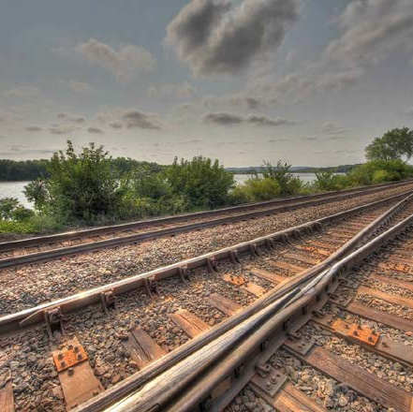
Prompt Medical Attention §20109 (c)(1)
Railroads are prohibited from denying, delaying, or interfering with the medical or first aid treatment of an employee injured during employment.
If transportation to a hospital is requested by an employee injured during employment, the railroad must promptly arrange to transport the injured employee to the nearest hospital where the employee can receive safe and appropriate medical care

Slide 11
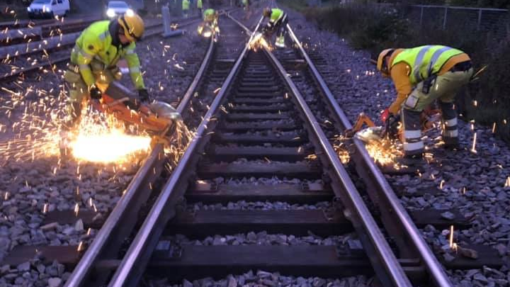
Examples of Prompt Medical Attention
A railroad may not delay medical treatment because it wants to take a statement from the injured employee before they are treated.
A railroad may not delay medical treatment because it wants to do a re-enactment of the accident before they are treated.
There is no reason which justifies a delay in prompt medical treatment.

Slide 12
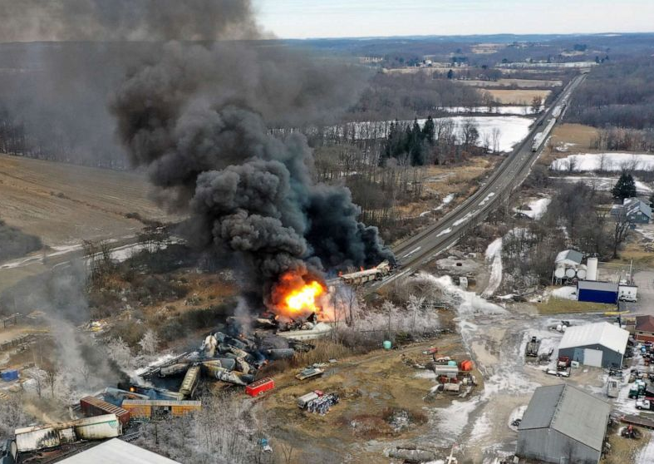
Most Importantly, this Includes:
Protected activity includes:
(iii) Refusing to perform unsafe work or authorize the use of unsafe railroad equipment, track, or structures.

Slide 13

Section 20109 prohibits a railroad from discriminating against an employee for engaging in protected activity.

Slide 14
Examples of Protected Activities:
Safety complaints and statements.
Accident, incident, and close call reports.
Injury reports.
Requests to be taken to a hospital.
Medical and first aid requests.
Following your doctor’s treatment plan.

Slide 15

Only Communicated Statements and Reports are Protected
Statements concerning safety and medical issues must be communicated in writing or orally to any of a wide variety of audiences:
  Railroad managers
  Railroad Foremen;
  Federal Railroad Administration;
  State rail inspectors;
  Senators and Congressmen (or staffers);
  EPA, NRC, DOE, DOT, and other federal agencies *

Slide 16
Not all Reporting of Safety and Accident-Injuries is Protected
Telling your family does not count;
Telling your friends does not count;
Telling your co-workers does not count unless one of the co-workers is at least a working foreman;
Reporting your story to the news media does not count;
But anonymous reporting might * be protected under the ‘right’ circumstances.

Slide 17
§20109 prohibits:
Discrimination (adverse personal actions) against employees who provide information regarding conduct:
  which the employee reasonably believes constitutes a violation of federal law, rule, or regulation relating to railroad safety or security
  or notifying or attempting to notify the railroad or FRA of a work-related personal injury

Slide 18
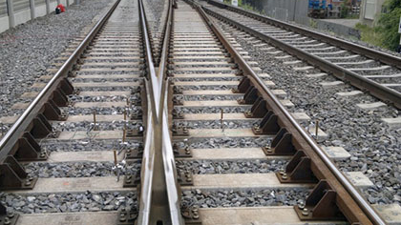
Scope of whistleblower protection for railroad employees
The employee protections under the OSHA whistleblower program effectively address a broad range of adverse employment actions which the railroads historically have taken against railroad workers.

Slide 19
Partial list of Prohibited
“Adverse Employment Actions” by Railroads
Firing or laying off
Abolishment of jobs
Blacklisting
Demoting
Denying overtime or promotion
Disciplining
Denying benefits
Failing to hire or rehire
Intimidation
Reassignment affecting promotion prospects
Reducing hours or pay

Slide 20
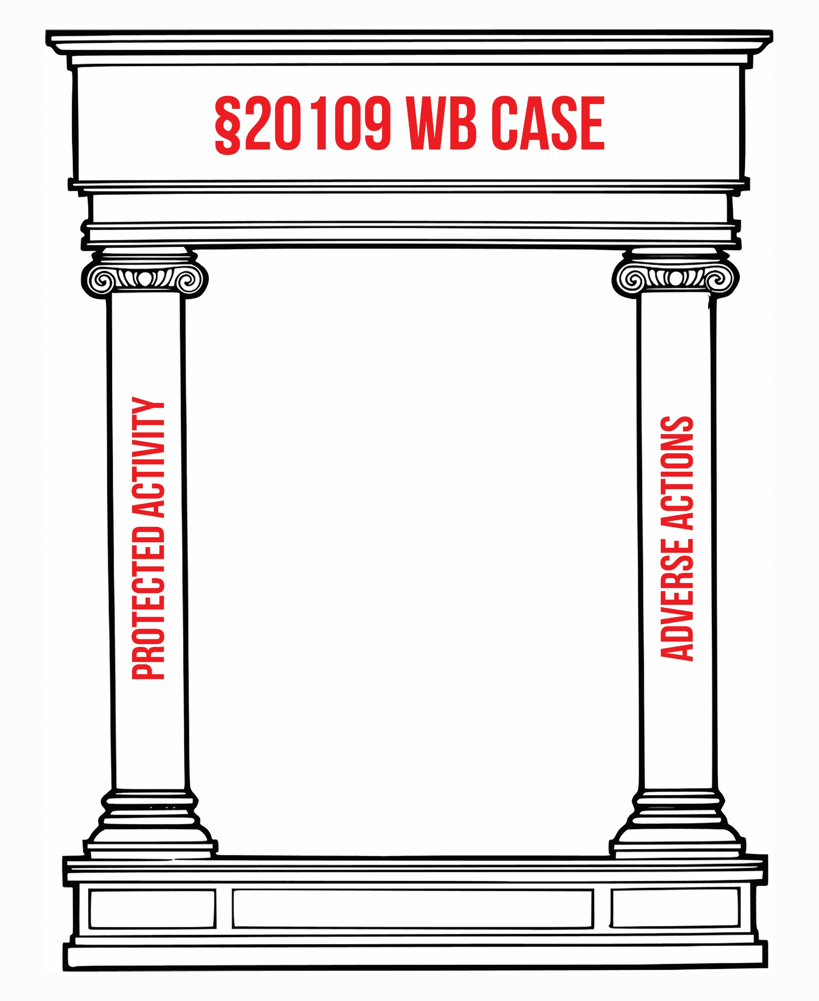
Do you have a case?
Notes:
Remember, you must engage in Protected Activity related to safety, security, injury reporting, or refusal to perform unsafe work AND have an Unfavorable (adverse) Action taken against you for such Protected Activity to have the basis for a WB case.
WB does not prevent RRs from harassing or intimidating you outside of Protected Activity related to safety, security, injury reporting, or refusal to perform unsafe work.

Slide 21

Overview of OSHA Investigation Procedure
The employee must file a claim with OSHA (although claims should be in writing, they may be filed by a telephone call to an OSHA office)
The complaint must be filed with DOL/OSHA within 180 days after the adverse employment action (i.e., when the retaliatory action was taken and communicated to the employee). Complaints should be filed with the assistance of a qualified attorney.
The Whistleblower law stipulates the parties’ “burden of proof”: A prima facie case by you; clear and convincing rebuttal by the railroad.
Notes:
Employees’ prima facie case burden is initially met when:
Employee shows they engaged in Protected Activity
Employer instituted an adverse employment action against employee in retaliation for such Protected Activity
OSHA will investigate the claim
After investigation, OSHA will issue findings; and
if a violation occurred, may issue a preliminary order providing relief to the employee

Slide 22

Current OSHA Investigation Procedures
The complaint will be assigned a regional investigator;
OSHA staff makes a preliminary assessment as to whether the case is timely filed;
The investigator is supposed to interview the complaining rail worker before reading the railroad’s written answer to the complaint *;
The investigator might not be trained in whistle-blower or rail safety cases;
The interview will possibly be recorded;
Workers have a right to have a union representative or lawyer present during the interview;

Slide 23

Current OHSA Investigation Procedures (Cont’d)
Before the interview, the worker and his/her lawyer can read the railroad’s written response.
This is a virtual ‘anything goes’ evidence process, and every effort to educate the OSHA investigator into the retaliatory nature of the industry and the carrier should be undertaken;
It is highly advisable to be completely open with the investigator, ensuring OSHA has the grievance Investigation transcript if there was one and other information not presented during it.
The investigator makes a probable cause/no probable cause decision (and remedies if favorable to the worker) and submit it for approval to the Regional solicitor and administrator. It will be sent to the parties and released to the news media if approved.
There are a broad set of written interim regulations governing OSHA’s handling of §20109 complaints and unpublished internal OSHA policies governing its procedures. This is complex and subject to change as the current rules are under review.

Slide 24

OSHA Administrative Appeals
If either party objects to OSHA’s findings, it may appeal to the DOL to have the case heard by an Administrative Law Judge (“ALJ”)
  The appeal must be within 30 days of OSHA’s ruling
  Rail workers have full rights of discovery: see 29 C.F.R. Part 18.13-18.22
  The ALJ will then conduct a full administrative trial on a de novo basis, and on the record;
  The decision of the ALJ may be appealed to the DOL Administrative Review Board (ARB). Note: the ARB is highly political, with all members selected by the Secretary of Labor and removable at will without cause.

Slide 25

Remedies
If you prevail, you are entitled to all relief necessary to make you whole.
Relief shall include, as applicable, reinstatement with the same seniority status, back pay with interest, and compensatory damages, including compensation for special damages such as litigation costs, expert witness fees, and reasonable attorney fees.
Relief may include punitive damages not to exceed $250,000. 49 U.S.C. § 20109(e).
These remedies are not theoretical; they are being awarded now by Administrative Law Judges (ALJs).

Slide 26
Example 1: A Safety Complaint Case
An Iowa track welder requested a lookout while performing work on adjacent tracks and asked for tools to make the field weld process safer. The Union Pacific Railroad responded by abolishing his welder position. No injury was involved: this was purely a safety complaint case. The worker filed a §20109 claim with OSHA. His commute was 131 miles longer, leaving him away from his family for extended periods and adding to his worker fatigue. The result: OSHA ordered the UP to reassign the worker to his former position, reimburse him for travel expenses, and pay compensatory damages associated with bringing the claim against the UP.

Slide 27
Example 2: An Injury Case Where the Discharged Employee Was Not Injured
New Jersey Transit found a worker guilty of violating company rules related to a severe injury case. The worker brought a §20109 claim. Result: OSHA ordered full back pay, make whole remedies, $5,000 for pain and suffering, $50,000 for the damage to his credit, $12,000 for the loss of his car, $346,000 for the loss of his home, $75,000 in punitive damages, plus attorney fees.

Slide 28
Example 3: A Case Where the Disciplined Employee Was Injured
A car maintenance worker injured her ankle in Seattle when she stepped off a rail car. Because she reported her injury, Amtrak, her employer, subjected her to discipline. She filed a §20109 complaint with OSHA. The result: she was awarded full back pay, $60,000 in compensatory and $100,000 punitive damages, plus attorney fees. Amtrak was ordered to post the notices that it promised not to engage in such conduct in the future.

Slide 29
Example 4: A Worker Reported An Injury
OSHA found Metro-North guilty of a violation of §20109 when it retaliated against a maintenance of way worker who reported an injury and ordered full make-whole remedies along with $5,000 for the lost opportunity for transfer or promotion, $5,000 for the inconvenience of and the mental anguish arising from Respondent’s intimidation and harassment of Complainant following the reporting of his occupational injury, and punitive damages in the amount of $75,000.

Slide 30
Overview of “Kick out” Provision:
How to get into Federal Court
If no final decision by SOL has been issued within 210 days, the employee may file a civil action in federal district court.
  Final OSHA decisions are rarely rendered within 210 days, and this option is essential to consider.
  It may take two years or more to obtain a final decision
  The federal court will hear the case on a de novo basis, and there is a right to a jury trial.
Where OSHA renders a final decision, adversely affected parties may file for review in a U.S. Court of Appeals within 60 days of the final SOL order. 49 U.S.C. §20109(d)(3-4).
Notes:
De novo is a Latin term that means "anew," "from the beginning," or "afresh." When a court hears a case “de novo,” it is deciding the issues without reference to any legal conclusion or assumption made by the previous court to hear the case.

Slide 31
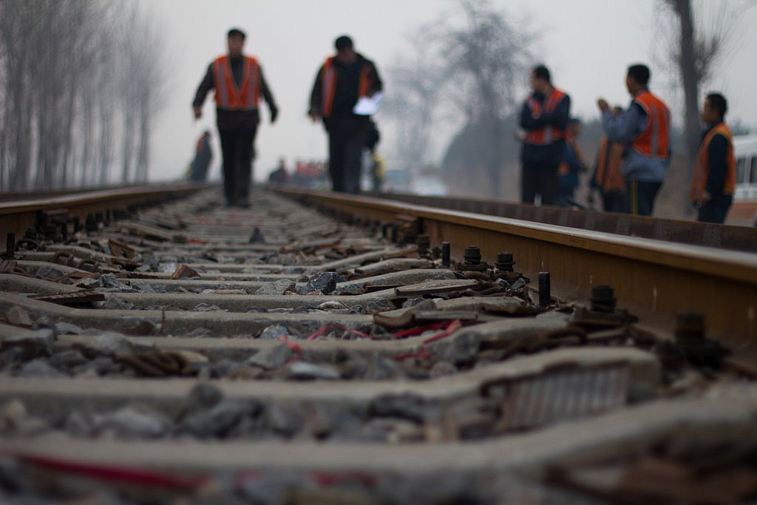
Related Legal Issues
Proposed settlements:
  OSHA approval is required to withdraw or settle claims;
  Rail carrier requests for release may be held to constitute an adverse action;
  Be aware of the relationship of §20109
    to FELA settlements;
    to Section 3, RLA settlements; and
    to other claims, such as divorce, bankruptcy, etc.

Slide 32
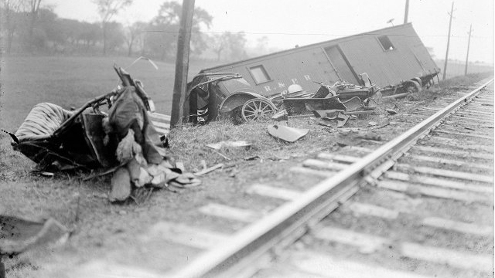
Important Legal Issues:
Election of remedies
  Use of RLA Section 3 grievance rights does not bar §20109 claims. However, the RLA Section 3 on-property disciplinary investigation must be coordinated with the § 20109 case!
  Pursuit of similar state law claims will bar later §20109 claims.
  Filing a FELA claim does not bar filing a §20109 claim.

Slide 33

Important Legal Issues
Do not assume witness identities or statements will be confidential
Be aware of the risk to co-workers in post complaint enhanced surveillance environment
Understand the “reasonable belief” standard
There is no protection in the ‘about to happen’ scenario
Owners but not operators of railroads may not be a “covered employer.”
Be aware of the pre-ALJ timing as a limit on the power of OSHA to compel the discovery of railroads.

Slide 34

Things to Consider
If claim involves the violation of medical rights and there is a parallel FELA claim, the member should seek advice from DLC, who should coordinate with the appropriate union officer.
Virtually all WB cases filed without legal counsel are unsuccessful. BMWED members are strongly encouraged to seek the advice of counsel in filing a WB complaint.

Slide 35
Other cases of interest
Division welder moves to a system position. He asked for gloves; weeks passed, and he was given a pair of used gloves. He had to weld under a tent and asked for ventilation, and he was given a 3M dust mask. He refused to perform welds that were not up to FRA regulations. He was disqualified. He filed a §20109 and had a successful result.

Slide 36
The Impact of §20109?
Whistleblower Protection under §20109 can be a real game changer for Rail Workers
Punitive damages, back pay, and make whole provisions will ultimately provide a financial incentive to carriers to cease their harassment and intimidation
Business as usual will not be tolerated by OSHA or BMWED

Slide 37
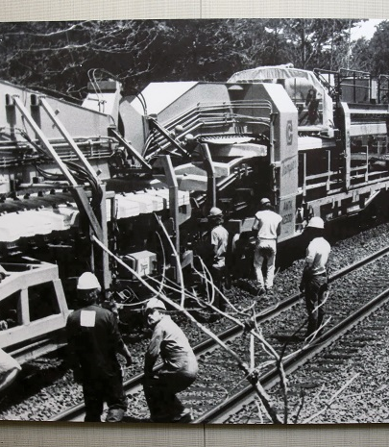
How Does §20109 Affect Safety?
FRA bases much of its rulemaking and safety activities on safety data
If accidents/injuries are not being reported properly, FRA is unable to focus its efforts on addressing the correct locations and causes.
§20109 protects RR employees who report accidents, injuries, and safety/security complaints free from harassment and retaliation.

Slide 38
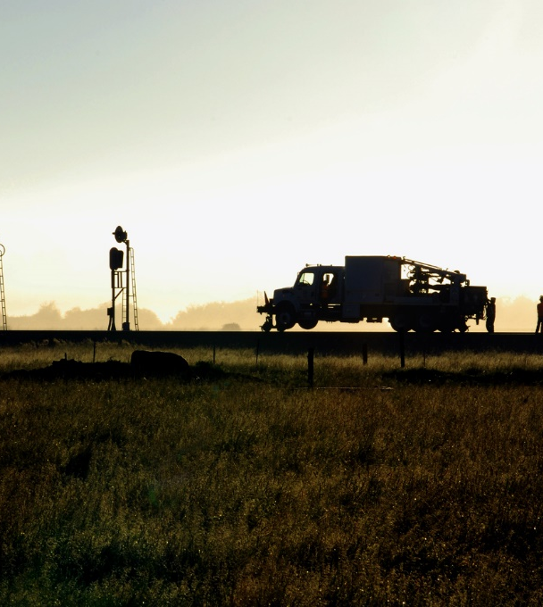
Websites of interest:
OSHA/DOL Whistleblower enforcement is found at: https://www.osha.gov/Publications/OSHA-factsheet-whistleblower-railroad.pdf
Notes:
One of the best private WB attorney websites is: http://www.gowhistleblower.com/Practice-Areas/Rail-Whistleblower-Library.shtml

